Slide 1


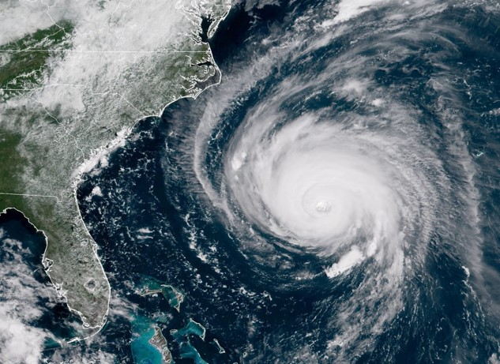
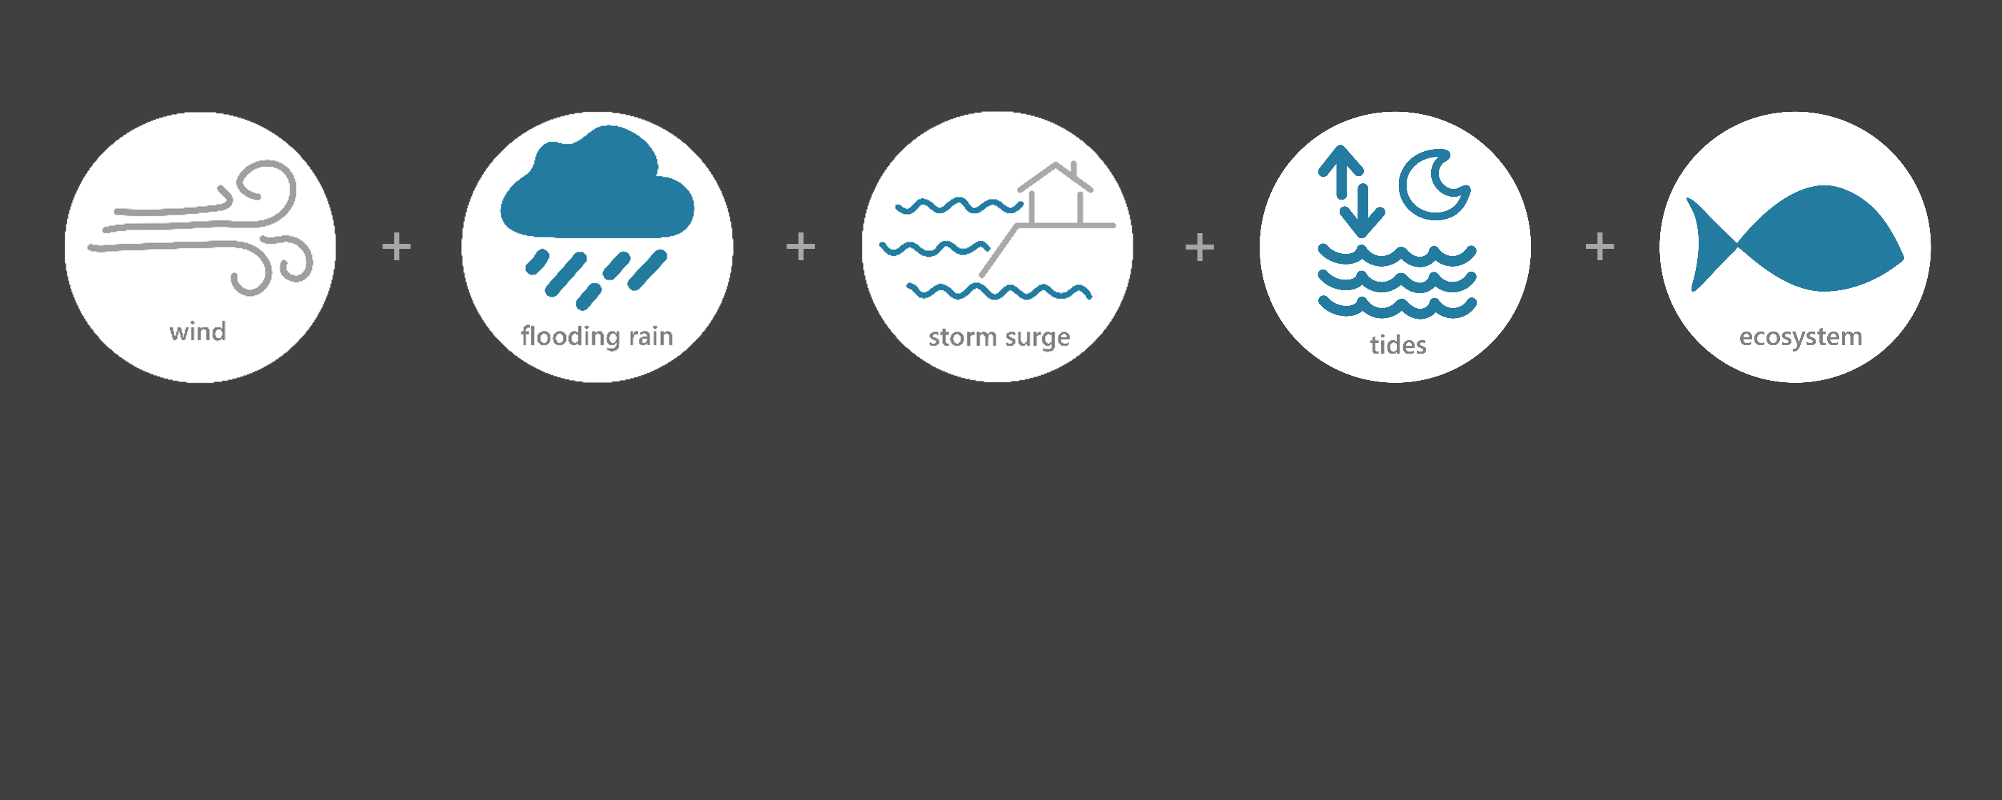

[ SEP 14 – SEP 18, 2018 ]
HURRICANE FLORENCE
TS
Category
(tropical storm)
0.25
Inches of Rain
22
Miles per hour
of Max Wind Speed
NR*
Feet of Storm Surge
(max)
Image Credit: NOAA, taken on September 12, 2018
Monitoring the Impact of Hurricane Florence at “Ace Basin NERR”
Hurricane Florence, a large and slow-moving Category 1 hurricane, made landfall along the southeastern coast of North Carolina. As Florence traveled inland across South Carolina, it weakened to a Tropical Storm. To the north of ACE Basin, wind damage and torrential rain that fell for days caused historic flooding at the North Inlet-Winyah Bay (NIWB) and North Carolina (NOC) NERR reserves. Local impacts to ACE Basin from Florence were minimal. The effects of Florence were observed at the ACE Basin Research Reserve through the System-Wide Monitoring Program (SWMP), which tracks short-term variability and long-term change of weather and water quality in the areas surrounding St. Helena Island, Edisto Beach and Beaufort and Colleton Counties, South Carolina.
Data shown are based on the ACE weather monitoring site
*NR = not recorded
Created on April 25, 2022

Slide 2

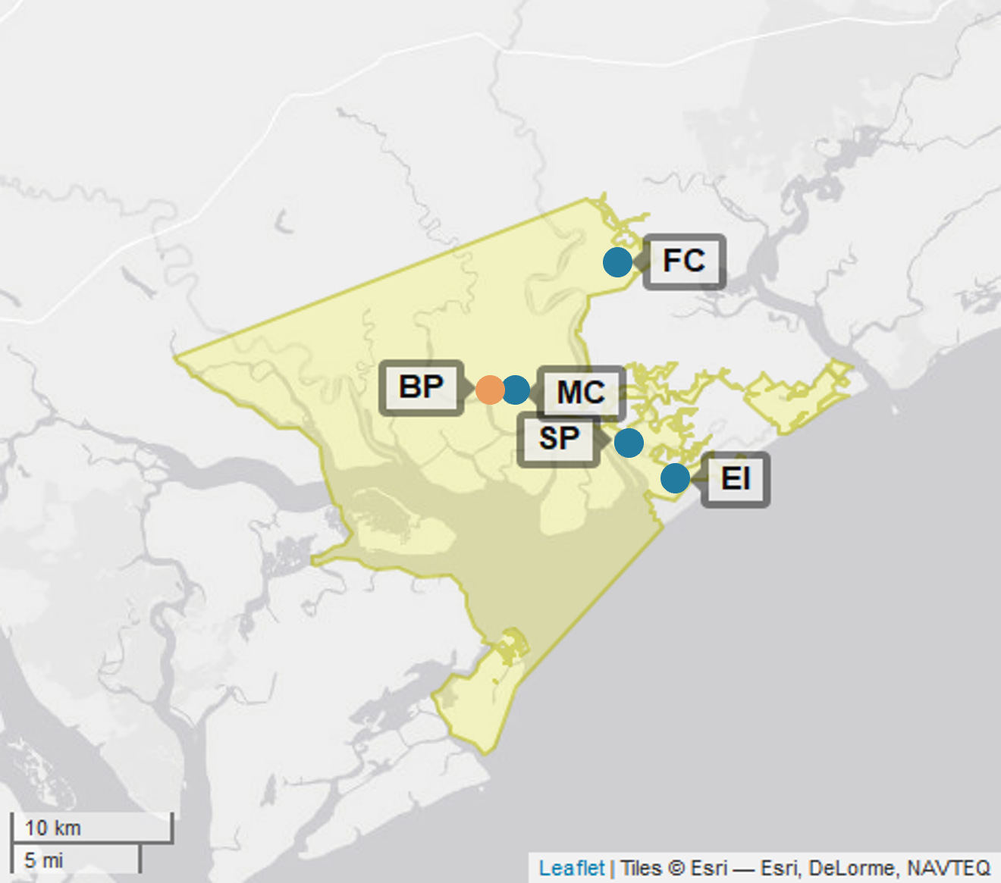
ACE
ACE Basin (Ashepoo-Combahee-Edisto) is one of 29 sites in the National Estuarine Research Reserve Systems (NERRS). Each site is a state-federal partnership that combines research, monitoring, and education to advance the understanding and management of estuarine environments.
NOC
NIWB
ACE
NERRS
Centralized Data
Management Office
ACE Basin Storm Monitoring
ACE Basin operates a weather station located at Bennett's Point (BP) and maintains six continuous, long-term water quality stations at Fishing Creek (FC), Mosquito Creek (MC) St. Pierre (SP), Grove Plantation (GP), JehosseeIsland (JI), and Edisto Island (EI) locations. ACE Basin is part of the SWMP. As Hurricane Florence approached South Carolina, ACE Basin monitored the weather and water quality, collecting data every 15 minutes for the following parameters: air temperature, relative humidity, atmospheric pressure, rainfall, wind speed and direction, water temperature, depth, salinity, dissolved oxygen, turbidity, and pH.
Weather Station
Water Quality Sample Location

Slide 3
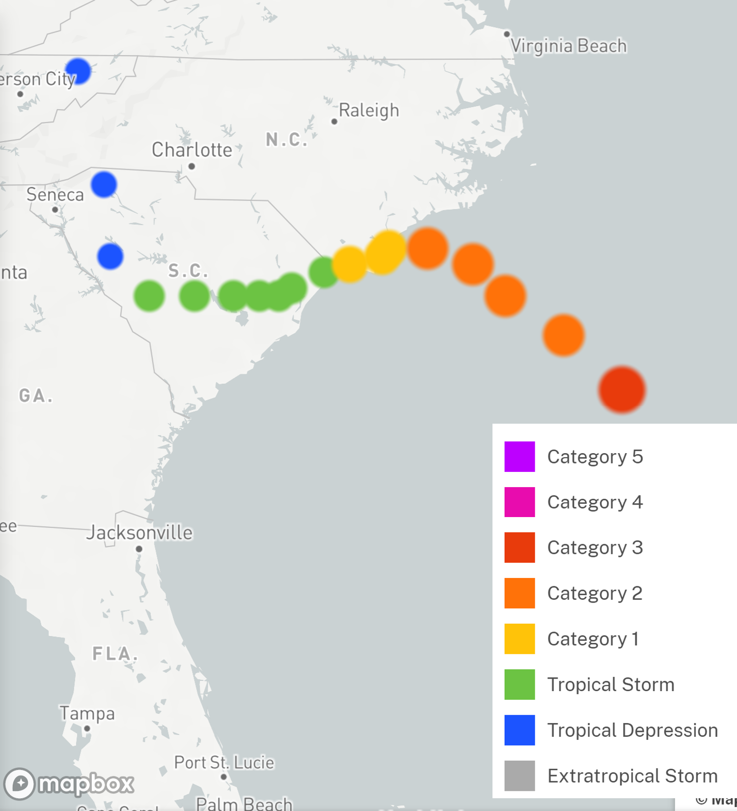
Florence made landfall near Wrightsville Beach, North Carolina on September 14. Florence stalled for an entire day before it began a slow turn to the southwest, traveling across South Carolina at a speed of 2-3 mph. The storm continued to weaken during September 15 and then traveled north-northeast out of the state on September 16.
Local impacts were minimal. Fatalities did occur in the counties and surrounding areas of the NIWB and NOC reserves. A total of 26 direct fatalities occurred in South and North Carolina as a result of freshwater flooding and downed trees. Extreme flooding experience in the areas of the NIWB and NOC reserves resulted in a lack of access to and from communities, complicating recovery and response efforts.
Source: https://oceanservice.noaa.gov/news/historical-hurricanes/
ACE
Local damage and losses were minimal. Losses due to Florence’s impacts totaled $2 billion in South Carolina and $22 billion in North Carolina.
Florence was a Category 1 on the Saffir–Simpson scale when it made landfall along the southeastern coast of North Carolina, and at the North Carolina (NOC) Reserve. As it moved to South Carolina and approached the North Inlet – Winyah Bay (NIWB) Reserve, it was a Tropical Storm. Florence’s path turned north and resulting int minimal impacts to the ACE Basin Reserve and surrounding areas.
Local impacts were minimal. Freshwater flooding in the areas of the NIWB and NOC reserves caused significant drops in salinity and dissolved oxygen levels for varying periods of time, potentially stressing aquatic life.
Reserve | Event | Rainfall Total (in) | Rainfall Average Intensity (in/hr) | Wind Speed Max (mph) | Wind Speed Average (mph)
ACE Basin Bennett's Point (BP) | 9/15/2018 | 0.2 | 0.0098 | 22.4 | 14.9
NIWB Oyster Landing (OL) | 9/14/2018 | 2.3 | 0.1208 | 41.2 | 32.0
NIWB Oyster Landing (OL) | 9/15/2018 | 3.5 | 0.1440 | 44.5 | 30.4
NOC Research Creek (RC) | 9/14/2018 | 2.6 | 0.3622 | 66.2 | 43.6
NOC Research Creek (RC) | 9/15/2018 | 0.4 | 0.0472 | 56.4 | 37.1
The highest local rainfall and wind measurements were recorded when Florence made landfall in North Carolina and then moved and traveled across South Carolina.
Data reporting time periods for Hurricane Florence: 9/14/2018 - 9/15/2018

Slide 4
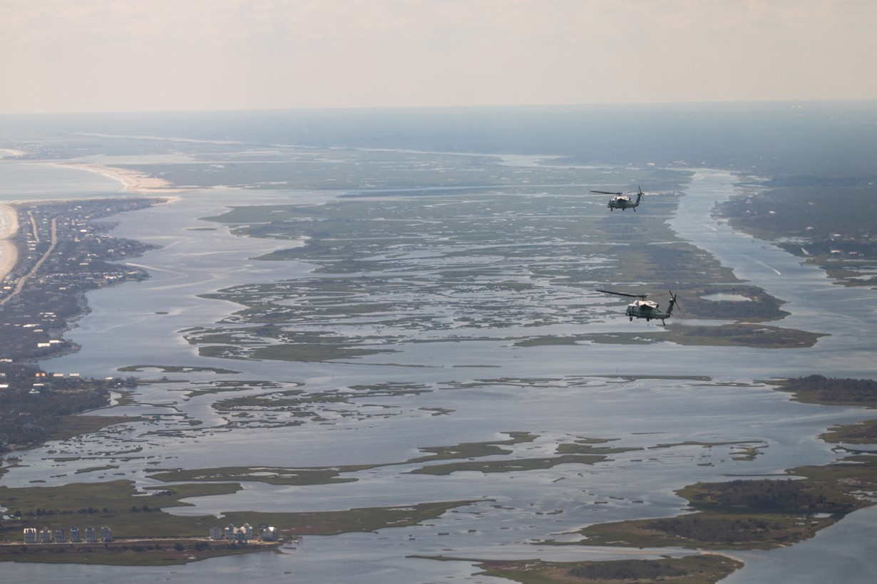
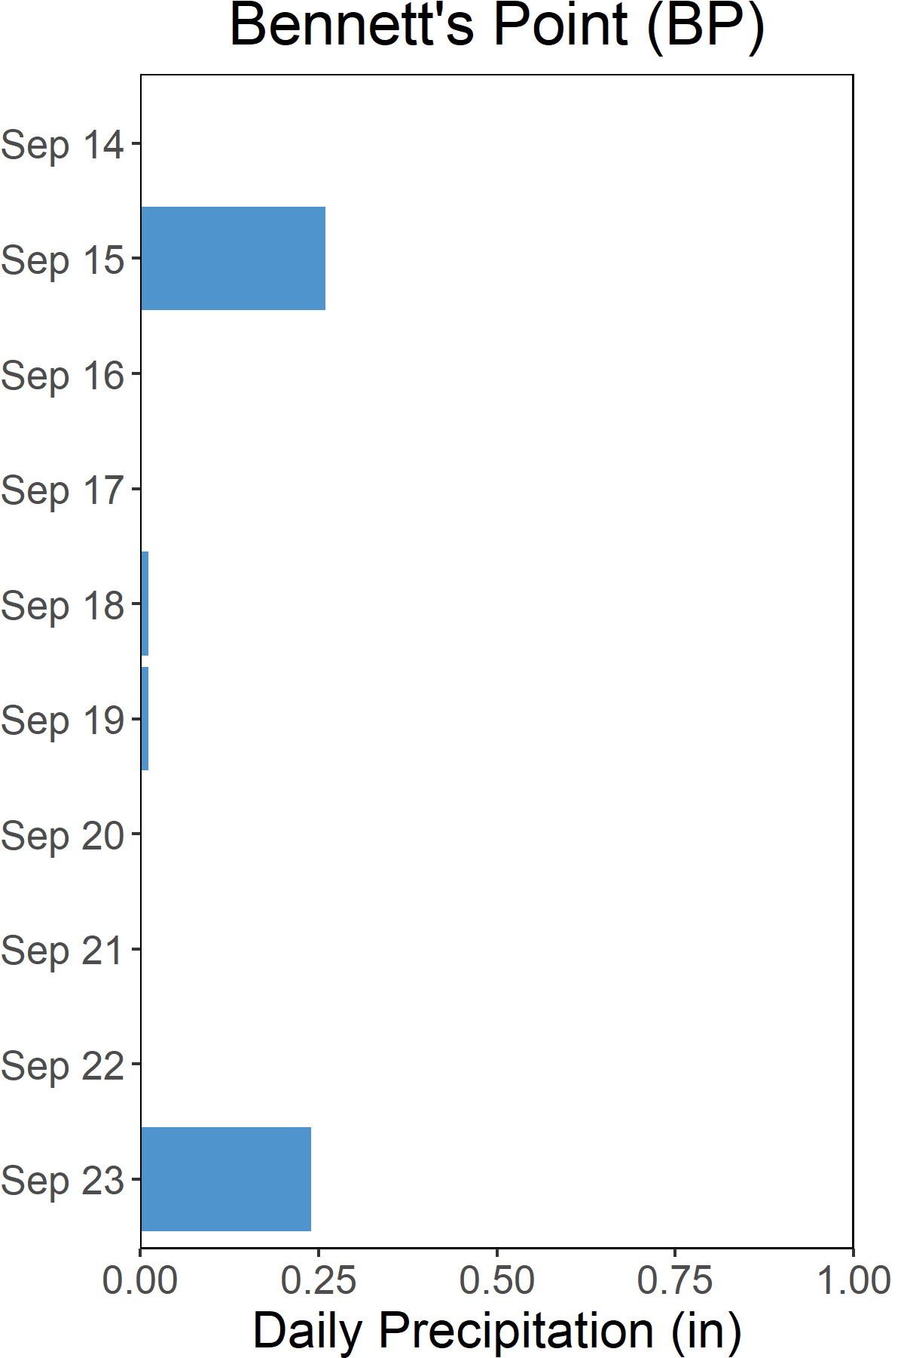

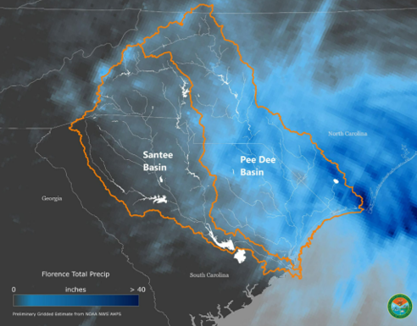
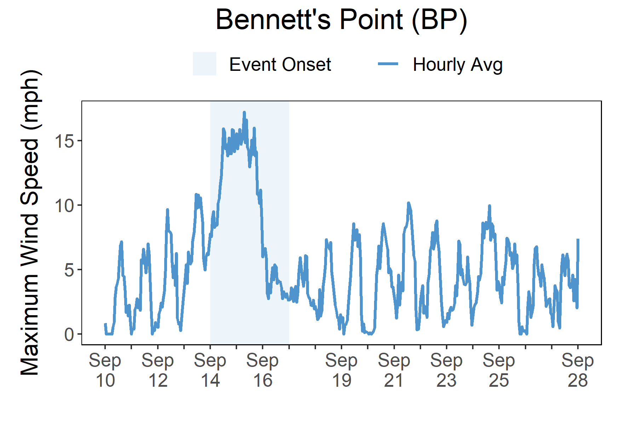

Rainfall
Florence brought heavy rains and freshwater flooding to South and North Carolina.
A total of 0.25 inches of rainfall fell in the reserve on Sept. 15 with minimal amounts falling in the following days. While local rainfall was minimal, rainfall measurement recorded at locations in the upper ACE Basin ranged from ~1 – 2.5 inches. In areas surrounding the NIWB and NOC, record rainfall amounts fell, ranging from >10 inches to almost 3 feet. The heavy rains caused extreme and historic flooding in these areas.
ACE
Precipitation Map from the SC DNR.
Hurricane and storm surge watches were issued for the coasts of South Carolina and North from Edisto Beach to the North Carolina-Virginia border on Sept. 11. The watches were then downgraded to a Tropical Storm warning for Edisto Beach to Ocracoke Inlet on Sept. 15. Local rain and wind impacts from Florence on the ACE reserve and the surrounding areas were minimal. However, many locations in South Carolina experienced four consecutive days of heavy rainfall due to the slow movement of Hurricane Florence, including the areas surrounding the North Inlet –Winyah Bay (NIWB) and North Carolina (NOC) reserves. At the NIWB reserve, the initial impacts from Hurricane Florence were felt locally from the heavy rains and high winds, including flooding, downed trees, power outages, and some damage to building structures. However, the most devastating impacts happened several weeks later. Impacts at the NOC reserve were felt immediately due to the heavy rains and high winds and then for days later due to the freshwater flooding. Florence's impacts included loss of life, power outages, impassable roads, damage to structures, and beach erosion.
Rainfall measurements at the Bennett’s Point weather station from Sept. 14 through Sept. 23.
Wind Speed
Max wind speed recorded at the reserve was 22 mph on Sept. 15.
Maximum Wind Speed readings at the Bennett’s Point weather station from Sept. 7 through Sept. 28.

Slide 5
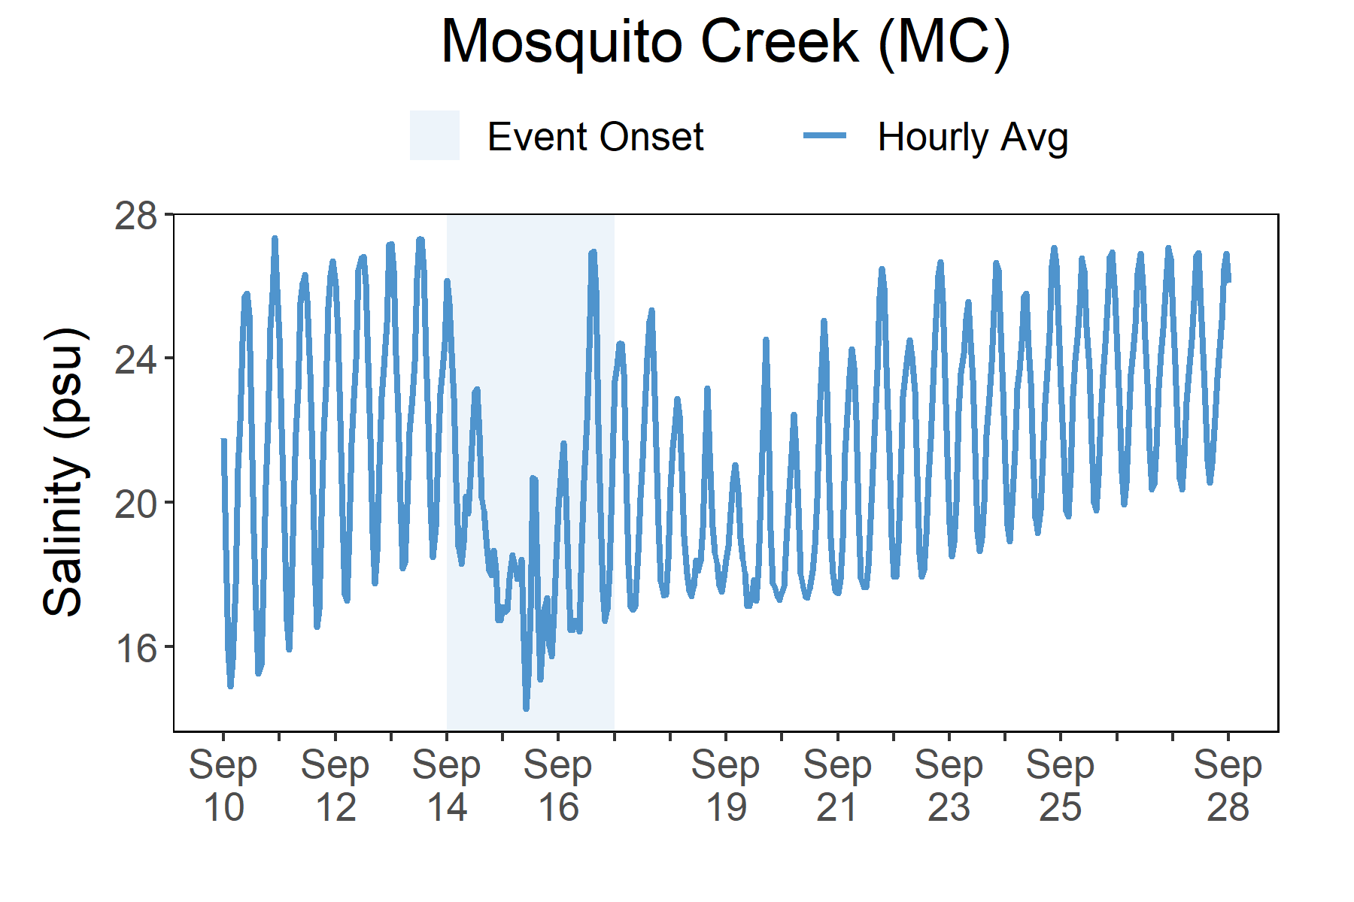
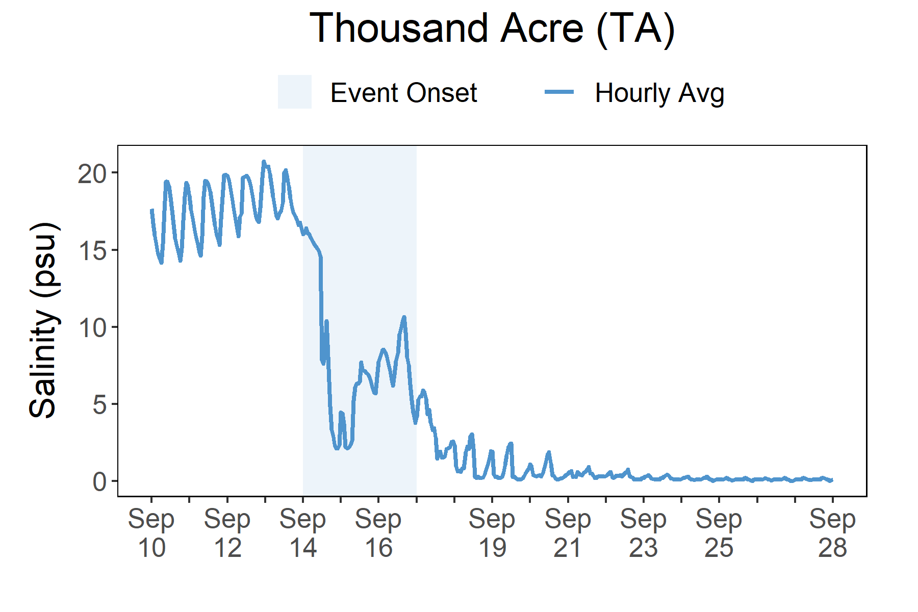
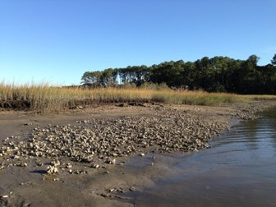
Salinity levels quickly dropped at Mosquito Creek (MC) as Florence approached the reserve. However, the water quality impacts were much less compared to NIWB and NOC.
Station | Event | Depth Maximum (ft) | Salinity Minimum (psu) | Salinity Maximum (psu) | Dissolved Oxygen Minimum (mg/L) | Dissolved Oxygen Maximum (mg/L)
ACE Basin Mosquito Creek (MC) | 9/15/2018 | 3.5 | 14.1 | 21.5 | 3.4 | 5.6
NIWB Thousand Acre (TA) | 9/14/2018 | 2.8 | 3.1 | 16.5 | 1.0 | 5.8
NIWB Thousand Acre (TA) | 9/15/2018 | 3.2 | 2.0 | 7.9 | 3.9 | 6.7
NOC Research Creek (RC) | 9/14/2018 | 3.8 | 28.8 | 35.0 | 5.6 | 6.5
NOC Research Creek (RC) | 9/15/2018 | 3.4 | 25.3 | 29.5 | 6.1 | 6.6
Data reporting time periods for Hurricane Florence: 9/14/2018 - 9/15/2018
Salinity (Ace Basin Reserve)
Salinity (niwb Reserve)
Post-Storm Levels
~17- >25 psu
A big and fast drop in salinity occurred as Florence
made its way to the reserve and then remained low due to extreme flooding days later
Pre-Storm
~13- >25 psu
Salinity levels dropped as Florence moved
across South Carolina
Pre-Storm
Levels ~11-20 psu
Post-Storm
Levels ~0-3 psu
Salinity levels from Sept. 7 to Sept. 28.
Salinity levels from Sept. 7 to Sept. 28.
Salinity levels that were recorded at the ACE reserve Mosquito Creek (MC) and NIWB reserve Thousand Acre (TA) station show initial and post-storm impacts on water quality in this area. However, the impact from Florence was minimal at ACE compared to NIWB where salinity levels quickly dropped at the onset of the storm, recovered slightly as the storm moved on, and then dropped significantly for an extended period of time as the area experienced extreme flooding. Dramatic changes in salinity and in other water quality e lower levels of oxygen (<6 mg/L) can cause stress to some aquatic organisms depending on the species and how long the levels deviate from what is normal. Water quality stresses can impact survival and future populations.
Every plant and animal species have habitat preferences and requirements. Understanding these habitats is critical to understanding populations.

Slide 6

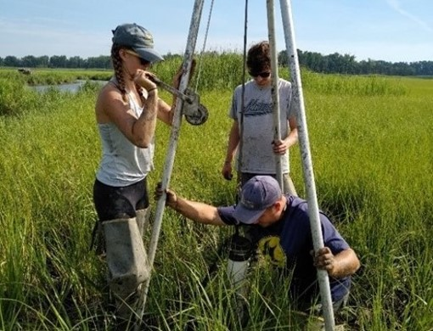
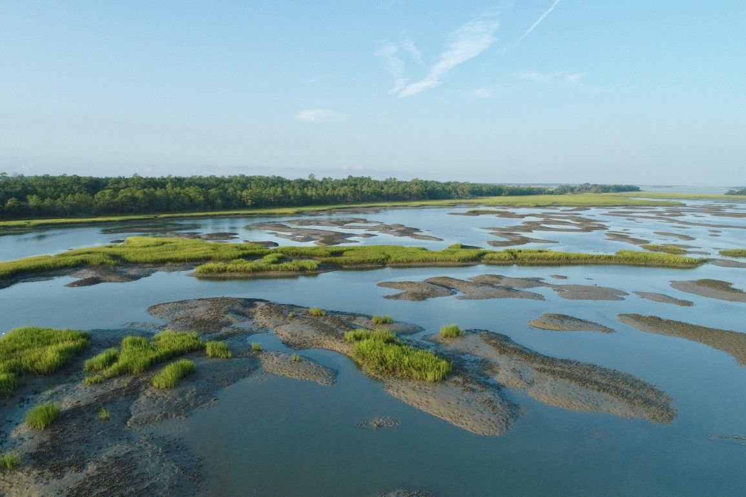
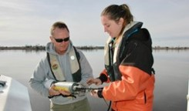
Saundra Upchurch, Research Biologist e: UpchurchS@dnr.sc.gov p: 843-953-9223
Visit www.nerrsdata.org to view and download weather and water quality data from Ace Basin NERR.
Interested in learning more? Visit www.dnr.sc.gov/marine/NERR/index.html For video, news updates, and online storm data and prediction visualization tools, check out our Storm Story Map at www.storm storymap.url
@estuaries

